Slide 1
6TH SENSE TECHNOLOGY
By
Nikhil Patil
KARMIC EMBEDDED SYSTEMS

Slide 2
CONTENTS
INTRODUCTION TO 6th SENSE TECHNOLOGY
REQUIREMENTS
WORKING OF SIXTH SENSE TECHNOLOGY
ADVANTAGES
REFERENCES

Slide 3
INTRODUCTION
SixthSense is a wearable gestural interface that augments the physical world around us with digital information and lets us use natural hand gestures to interact with that information.
Steve Mann is considered as the father of sixth sense technology.
The Sixth Sense prototype is comprised of a pocket projector, a mirror,colored marker and a camera.

Slide 4
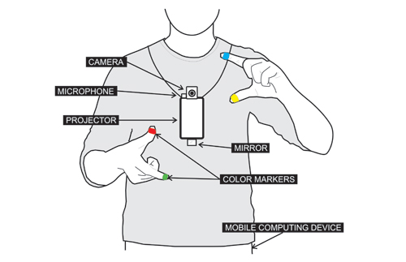
REQUIREMENTS
HARDWARE
Any windows computer/Laptop
A camera
Projector
Colour markers
(Like: Red, Yellow, Blue & Green)

Slide 5
REQUIREMENTS
SOFTWARE
Direct X
Visual studios
Adobe Flash player (active x)
MS Outlook
Internet connection is also required

Slide 6
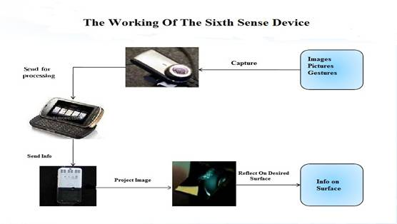
WORKING OF SIXTH SENSE TECHNOLOGY

Slide 7
Continued..
video for adding colour markers
http://www.youtube.com/watch?feature=player_embedded&v=fufvs4JgI_I' target='_blank'>http://img.youtube.com/vi/fufvs4JgI_I/0.jpg' width='425' height=344 />

Slide 8
ADVANTAGES
Portable
Cost effective
Connectedness between real world and digital world
Mind map the idea anywhere
Open source software

Slide 9
REFERENCES
https://code.google.com/archive/p/sixthsense/

Slide 10
THANK YOU
FOR YOUR
VALUABLE TIME.
ANY
QUESTIONS?

